Slide 1
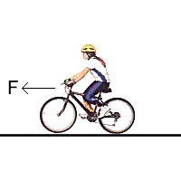
Newton’s 1st Law of Motion, Weight & Applying Newton’s 2nd Law
System
Chapter 6.2

Slide 2
What You Already Learned
Newton’s 2nd Law of Motion.

Slide 3



Inertia
Inertia was a term first coined by Galileo.
  He suggested that objects in motion would remain so unless acted upon by friction.

Slide 4
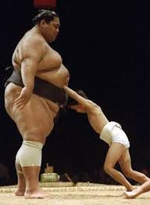
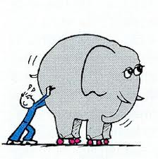
Inertia
  Inertia is an objects resistance to change in motion.
    For two objects of the same size, the more mass an object has, the more inertia it has.
    Mass is a measure of an object’s Inertia!

Slide 5
Newton’s 1st Law of Motion
Newton later revised Galileo’s theory:
  An object in motion will remain in motion in a straight line with constant speed unless acted upon by an unbalanced force.
and
  An object at rest will remain at rest unless acted upon by an unbalanced force.
Newton’s 1st Law of motion is also known as the Law of Inertia.

Slide 6
Inertia and Motion
If the net sum of external forces on an object was equal to zero, would the object change direction or accelerate?
No
  If the forces are balanced, then no acceleration or change in direction will occur.
F_{ground-on-car}
If the forces are balanced, then the vehicle will continue to travel at a constant velocity.
F_{friction}
F_{forward}
System
F_{gravity}

Slide 7

Misconceptions about Forces
Is a force required after a ball is released while throwing to make it continue in its path?
  No: once the contact force between the hand and the ball are broken, there is no longer a force pushing the ball forward.
  However, gravity will act on it causing it to have a parabolic trajectory.

Slide 8
Misconceptions about Forces
Is inertia a force?
  No: Inertia is the tendency for an object to resist a change in velocity.
  Inertia is a property of matter.
  The more mass an object has, the more inertia it has.
  Forces that exist in the environment act on objects.

Slide 9
What’s the difference between mass and weight?
Mass is a property of an object that quantifies (provides a numerical value) the amount of matter (protons and neutrons) that it contains.
Weight is a measure of the force exerted on a body by gravity, which is directly related to the amount of mass and acceleration due to gravity.
Mass is the same everywhere in the universe, while weight will vary with the mass and distance from other bodies.
NOTE: You may consider MASS and INERTIA to be the SAME!
Mass and Weight are not the same.

Slide 10
Determining Weight
If the mass of an object is known, its weight can be determined using Newton’s 2nd Law of Motion.
  F_{g} = mg
  Where:
    m = mass
    g = acceleration due to gravity (g = 9.81 m/s²).

Slide 11
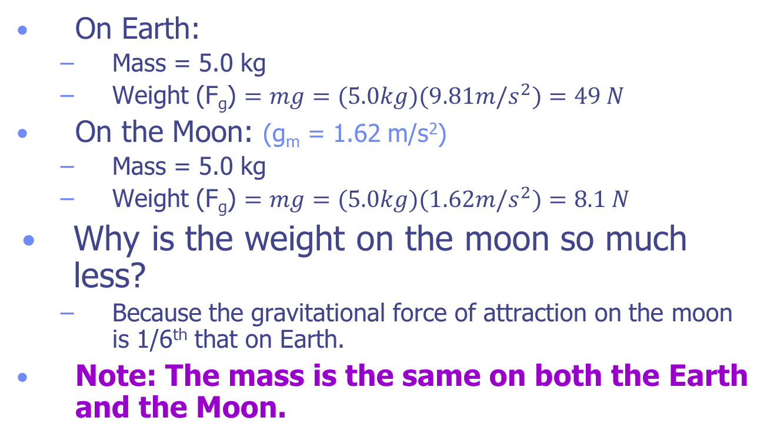
Example: Weight vs. Mass
On Earth:
  Mass = 5.0 kg
  Weight (F_{g}) $=mg=(5.0kg)(9.81m/s^{2})=49 N$
On the Moon: (g_{m} = 1.62 m/s²)
  Mass = 5.0 kg
  Weight (F_{g}) $=mg=(5.0kg)(1.62m/s^{2})=8.1 N$
Why is the weight on the moon so much less?
  Because the gravitational force of attraction on the moon is 1/6th that on Earth.
Note: The mass is the same on both the Earth and the Moon.

Slide 12
Example: Weight vs. Mass
What is the trend?
As mass increases, so does the weight
Slope = ?
Acceleration due to Gravity
g
Weight (N)
Mass (kg)

Slide 13
Example 1: How will your weight change?
You have a mass of 75 kg and are standing on a bathroom scale in an elevator. The elevator accelerates from rest at a rate of 2.0 m/s² for 2 s and then continues at constant speed.
  What is the scale reading during acceleration?
  How does this reading compare to that of the scale at rest?
  How does this reading compare to that of the scale when the elevator is moving at constant v?

Slide 14
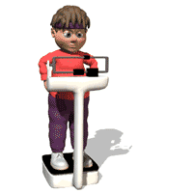
Diagram Problem
+y
F_{scale}
F_{scale}
F_{net}
a
System
F_{gravity}
F_{gravity}
F_{net} = F_{scale} - F_{gravity}

Slide 15
State the Known and Unknowns
What is known?
  Mass (m) = 75 kg
  Acceleration (a) = 2.0 m/s²
  Time (t) = 2.0 s
What is not known?
  F_{scale} = ?

Slide 16
Perform Calculations
F_{net} = F_{scale} – F_{gravity} (1)
  Where:
  F_{net} = ma
  F_{gravity} = mg
Rearranging (1) to solve for F_{scale}:
  F_{scale} = F_{net} + F_{gravity}
  F_{scale} = ma + mg
  F_{scale} = m(a + g)
  F_{scale} = (75 kg)(2.0 m/s² + 9.8 m/s²)
  F_{scale} = 890 N

Slide 17
Scale Reading at Rest and Constant Speed
When the elevator is at rest or not accelerating, equation (1) [F_{net} = F_{scale} – F_{gravity}] reduces to:
F_{scale} = F_{gravity}
Since the forces are balanced, there is no acceleration (Newton’s 1st Law of Motion) and F_{Net} = 0.
F_{scale} = mg = (75kg)(9.81m/s²) = 740N

Slide 18
Key Ideas
Inertia is a measure of an objects resistance to change in motion.
Newton’s 1st Law of motion is also known as the law of inertia.
Size being equal, the more mass a body contains, the more inertia it has.
If the sum of the forces on a body equal zero, then the object will remain at rest, or remain in motion at a constant velocity.

Slide 19
Key Ideas
Mass is a property of a material that is a measure of the amount of matter it contains.
Weight is a measure of the force on an object that is proportional to its mass and acceleration due to gravity.

Slide 20
Misconceptions about Forces
Does air exert a force?
  Yes
    Objects that are not moving relative to their surroundings experience a balance of forces due to the air in the atmosphere (Barometric pressure = 101.3 Pa = 14.7 psi).
    Objects in motion experience air resistance, a frictional force due to air acting on the side of the object facing the direction that it is moving. As the cross-sectional area increases the air resistance increases.
      Ex. Air drag on skydivers, automobiles, etc.

